Slide 1
The Element Dice System

Slide 2
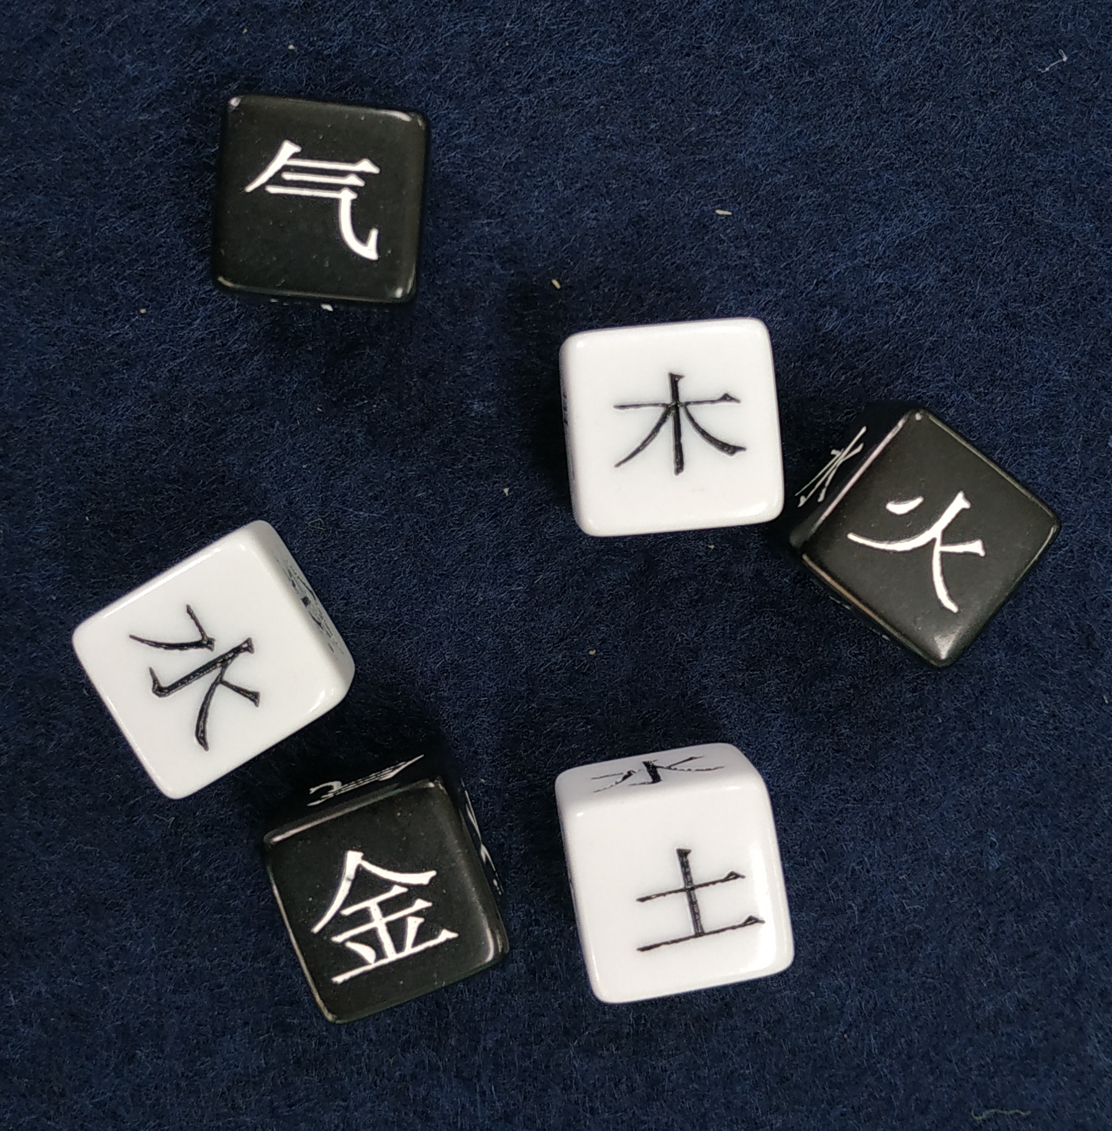
Basics
The Element Dice System is build on the philosophy of Yin and Yang.
The Dice show the 5 elements/powers
Wood 木
Fire 火
Earth 土
Metal 金
Water 水
and Qi 气 - the omnipotent energy that creates Yin and Yang and the elements.

Slide 3
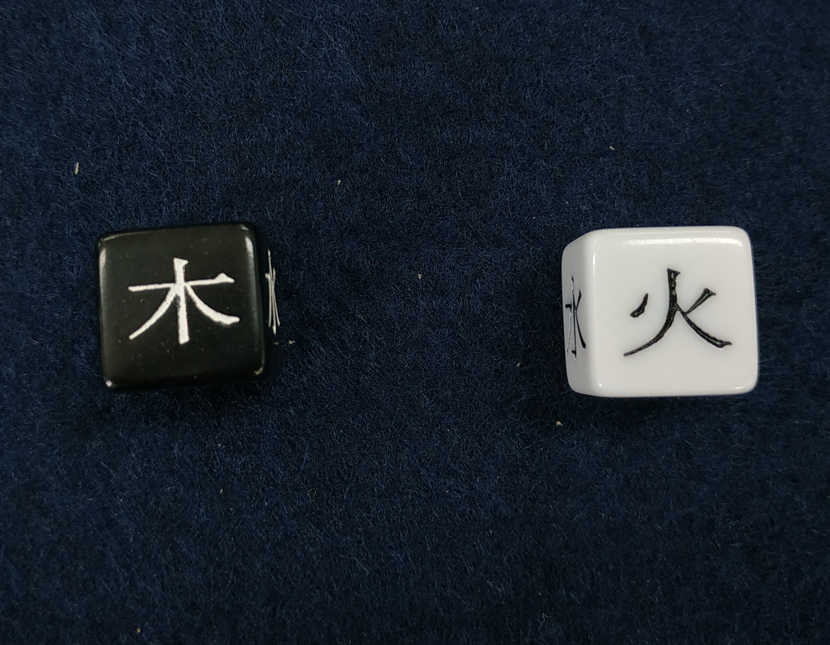
Creating a Dice Pool
Creating a Dice pool follows the idea of:
difficulty (Yin – black dice)
vs.
proficiency (Yang – white dice)
The basic dice pool is always
One black die (Yin)
against
One white die (Yang)

Slide 4
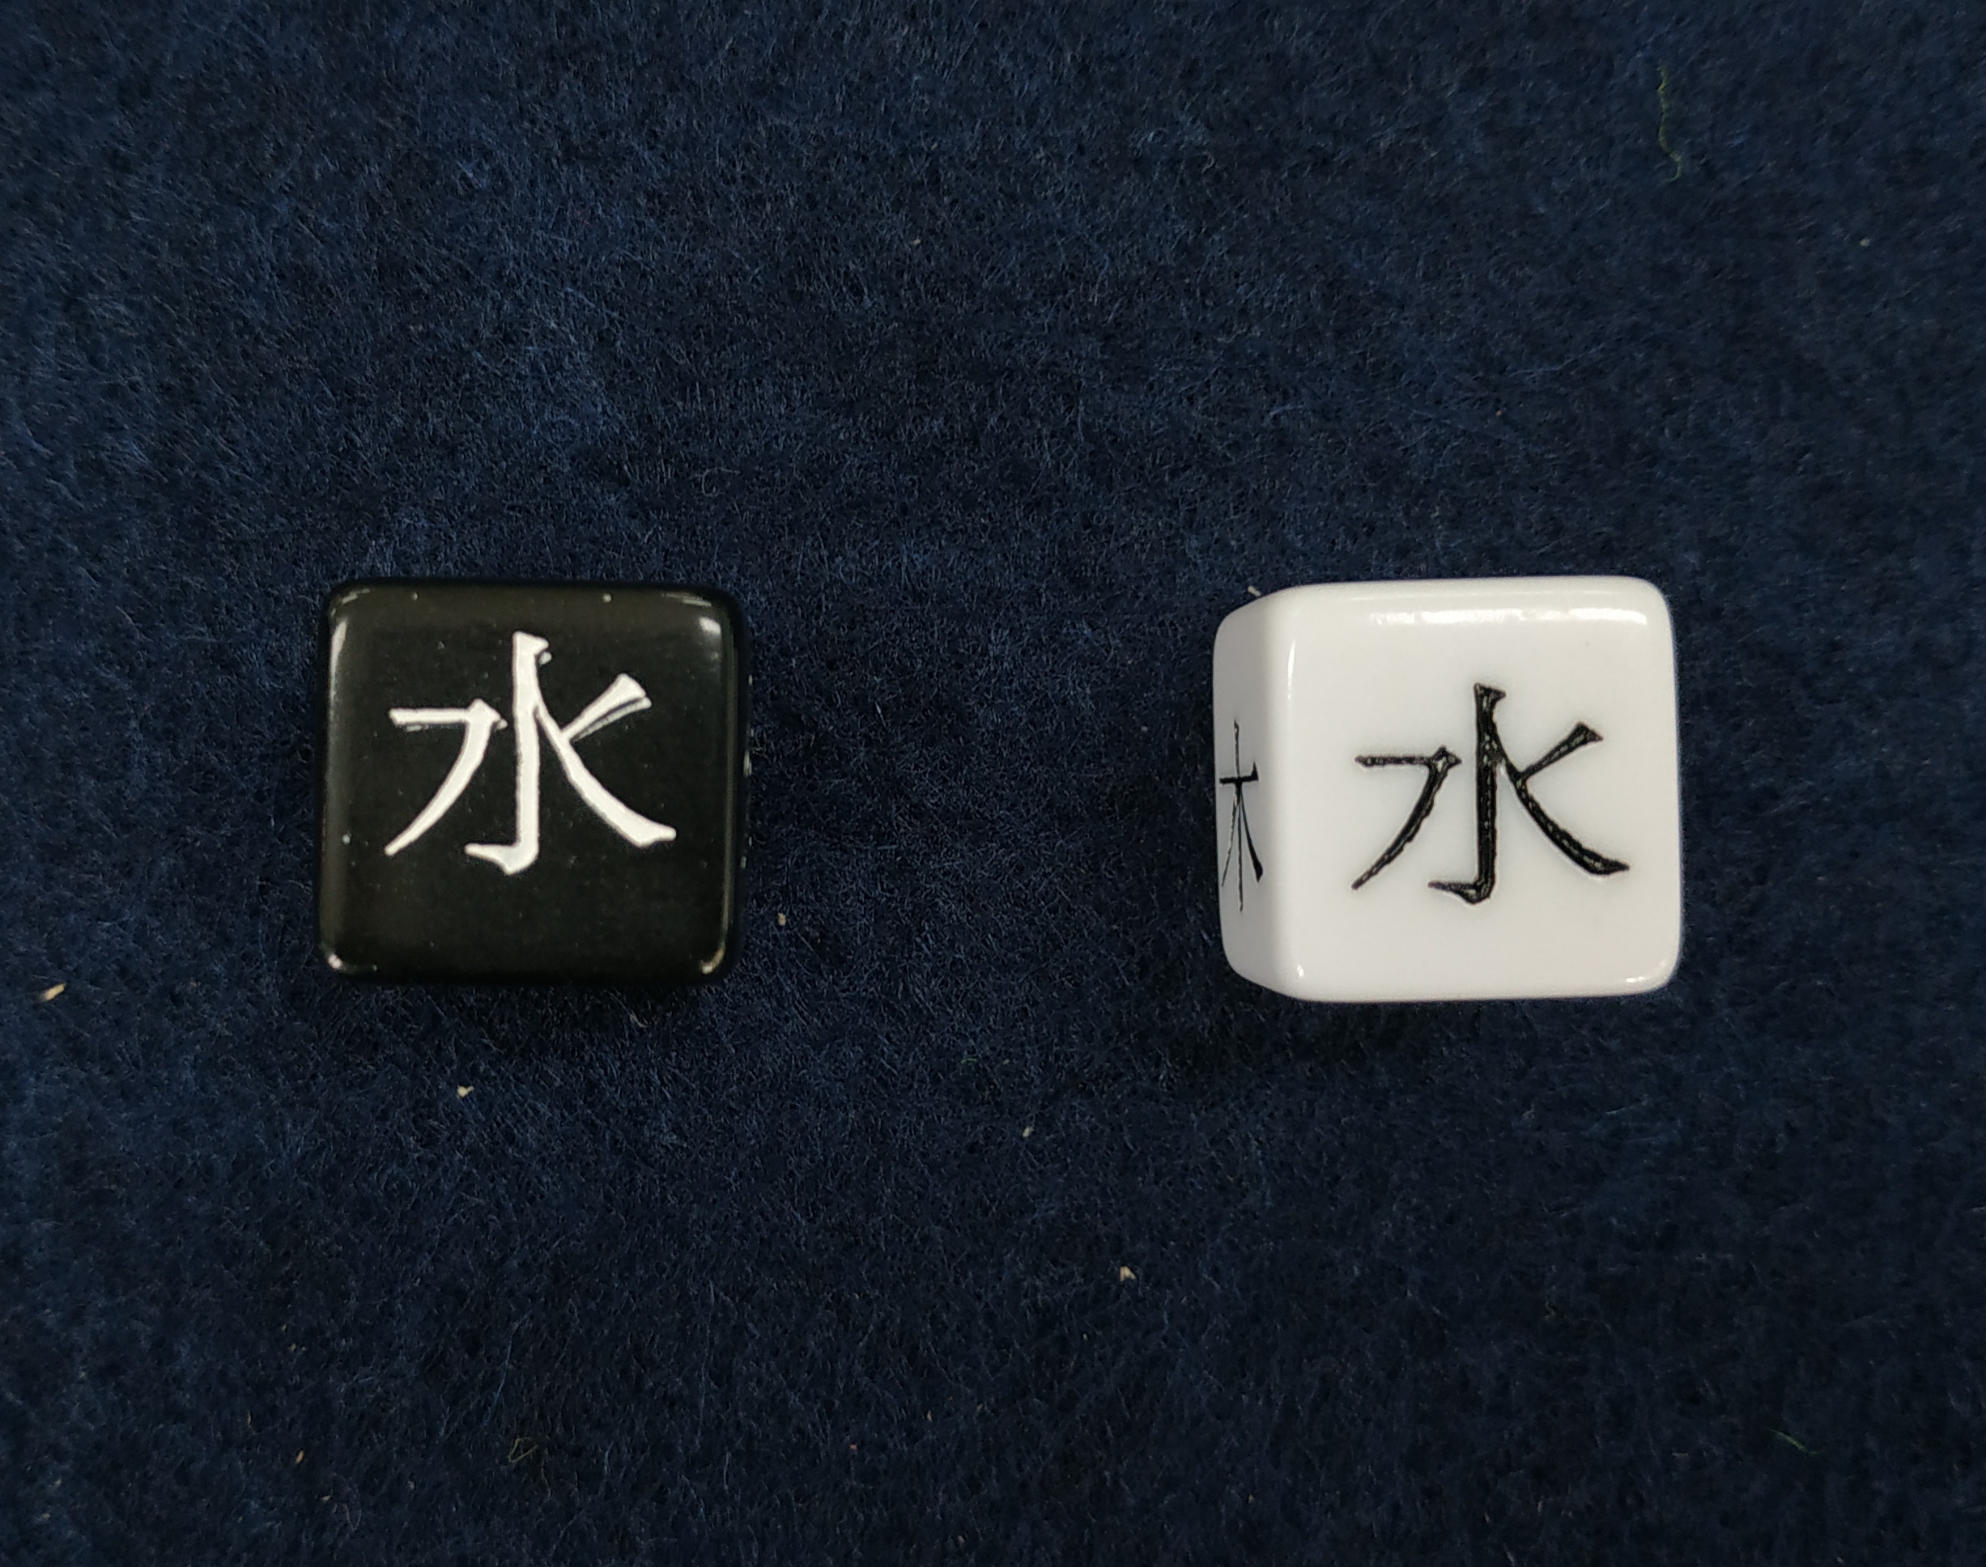
Basic Pool
The basic dice pool represents a simple roll for an action or to gather information about the scene.
No side, neither Yin nor Yang, has an advantage.
The system, however, sides with the players unless the players decide to set a darker, more difficult tone for their game.
This means, when an the same number of dice are left in your roll at the end, the attempted action succeeded, just not very well.

Slide 5
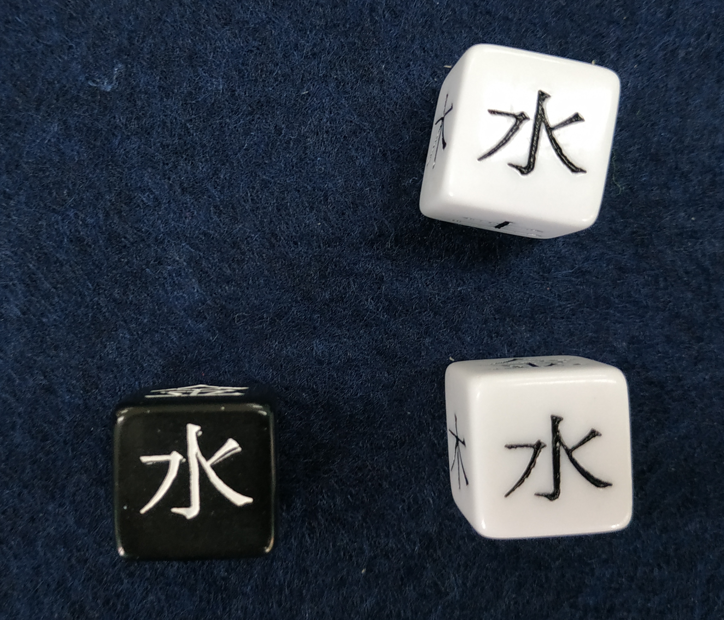
Simple advantage for the players
To represent an advantage for the players, one extra Yang die can be added into the dice pool.
This advantage could come from
Proficiency of the character based on their background
Players are working together
The scene has established an advantage before

Slide 6
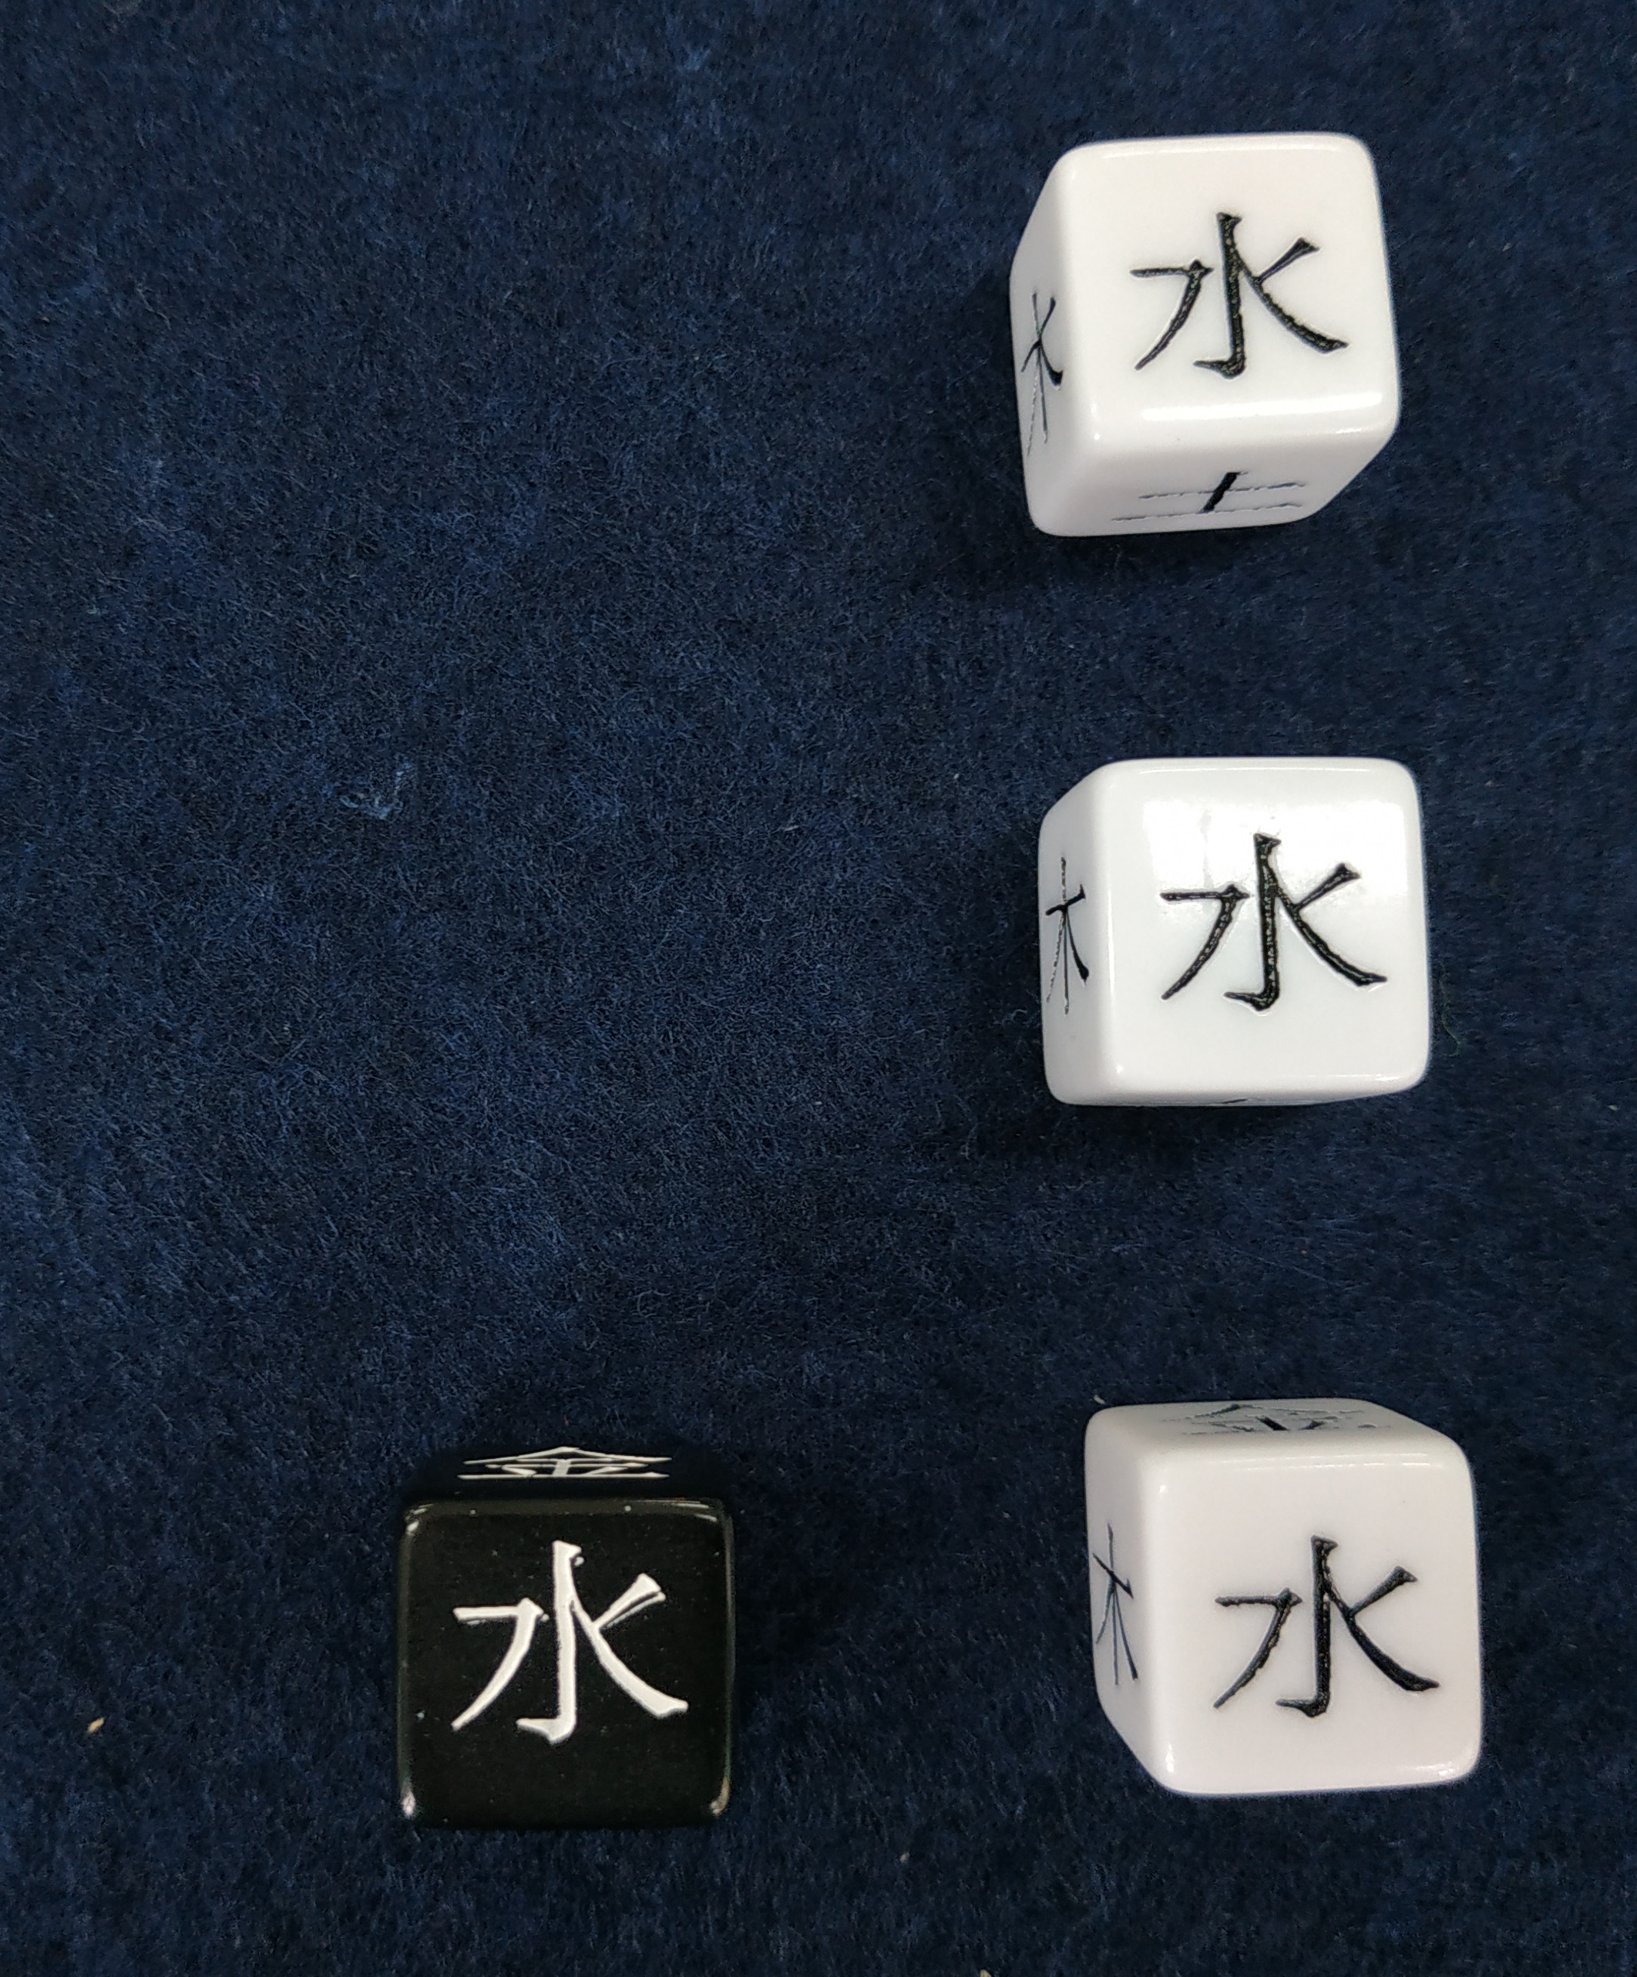
Great advantage for the players
To represent a great advantage for the players, two extra Yang dice can be added into the dice pool.
This advantage could come from
Proficiency of the character based on their background
Players are working together
The scene has established an advantage before

Slide 7
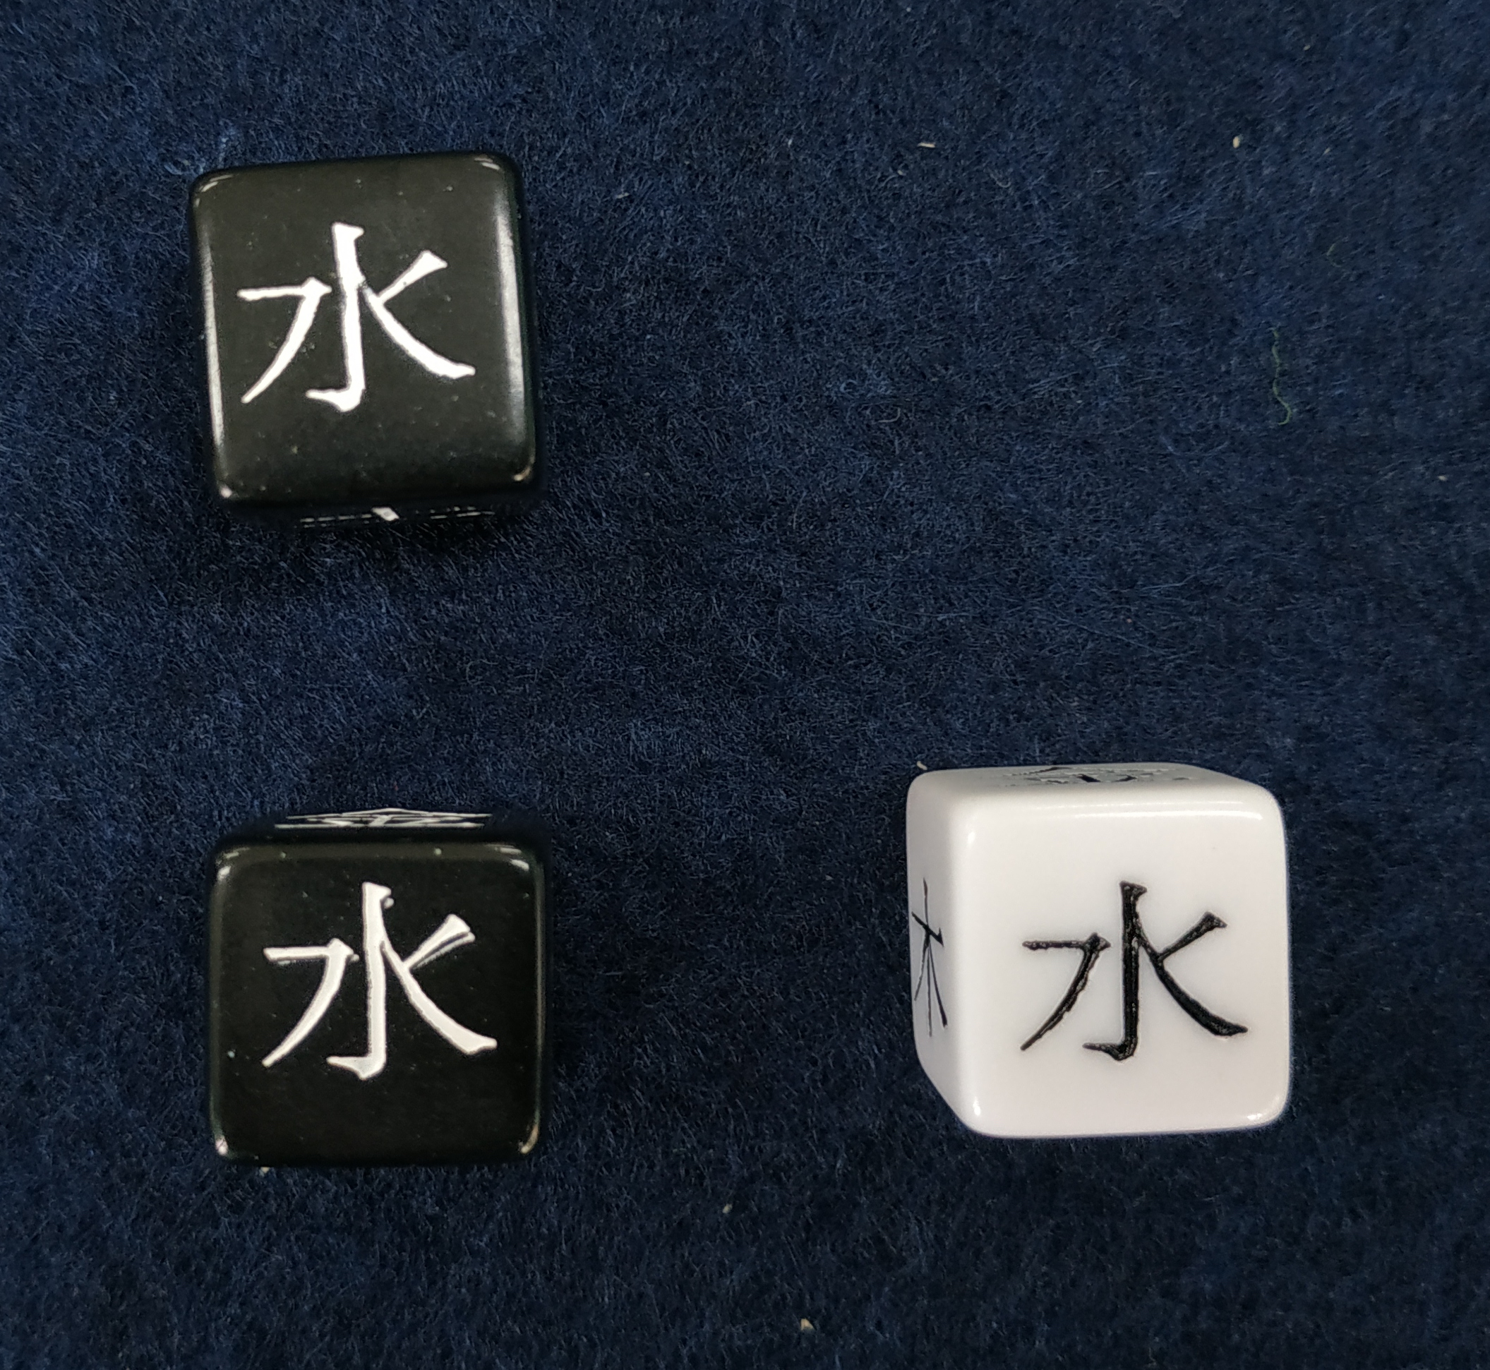
Simple disadvantage for the players
To represent a disadvantage for the players, one extra Yin die can be added into the dice pool.
This disadvantage could come from
The difficulty of the action
The difficulty to obtain the information
The scene has established a disadvantage before

Slide 8
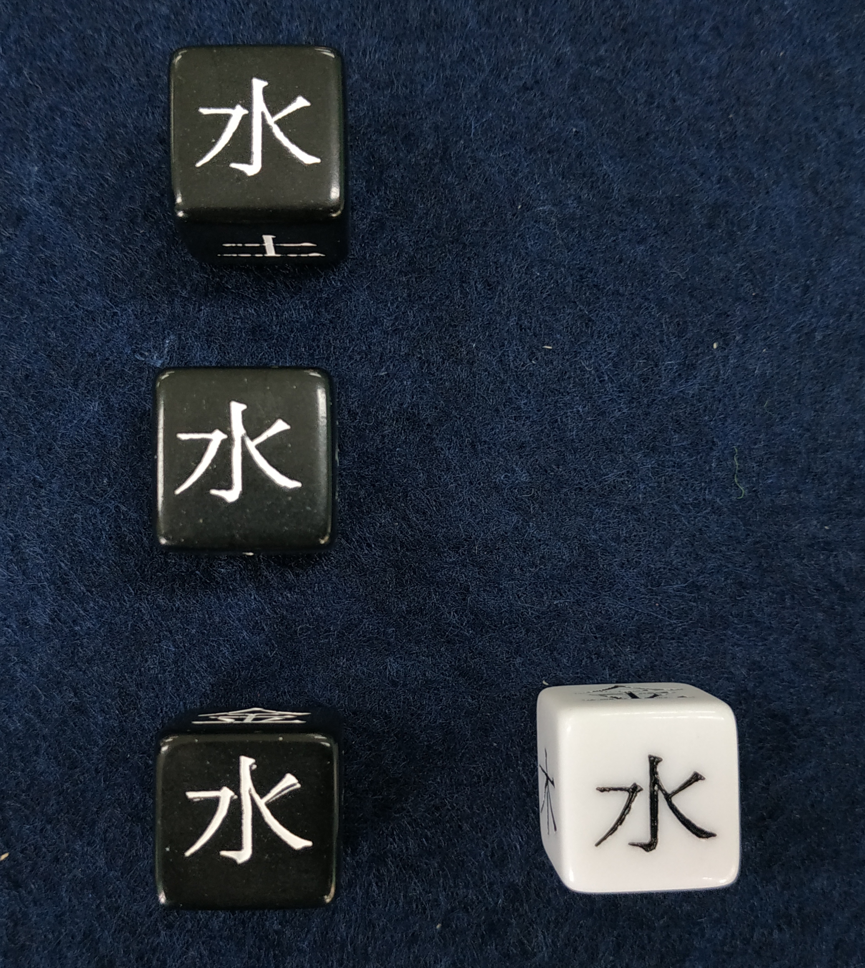
Great disadvantage for the players
To represent a great disadvantage for the players, two extra Yin dice can be added into the dice pool.
This disadvantage could come from
The difficulty of the action
The difficulty to obtain the information
The scene has established a disadvantage before

Slide 9
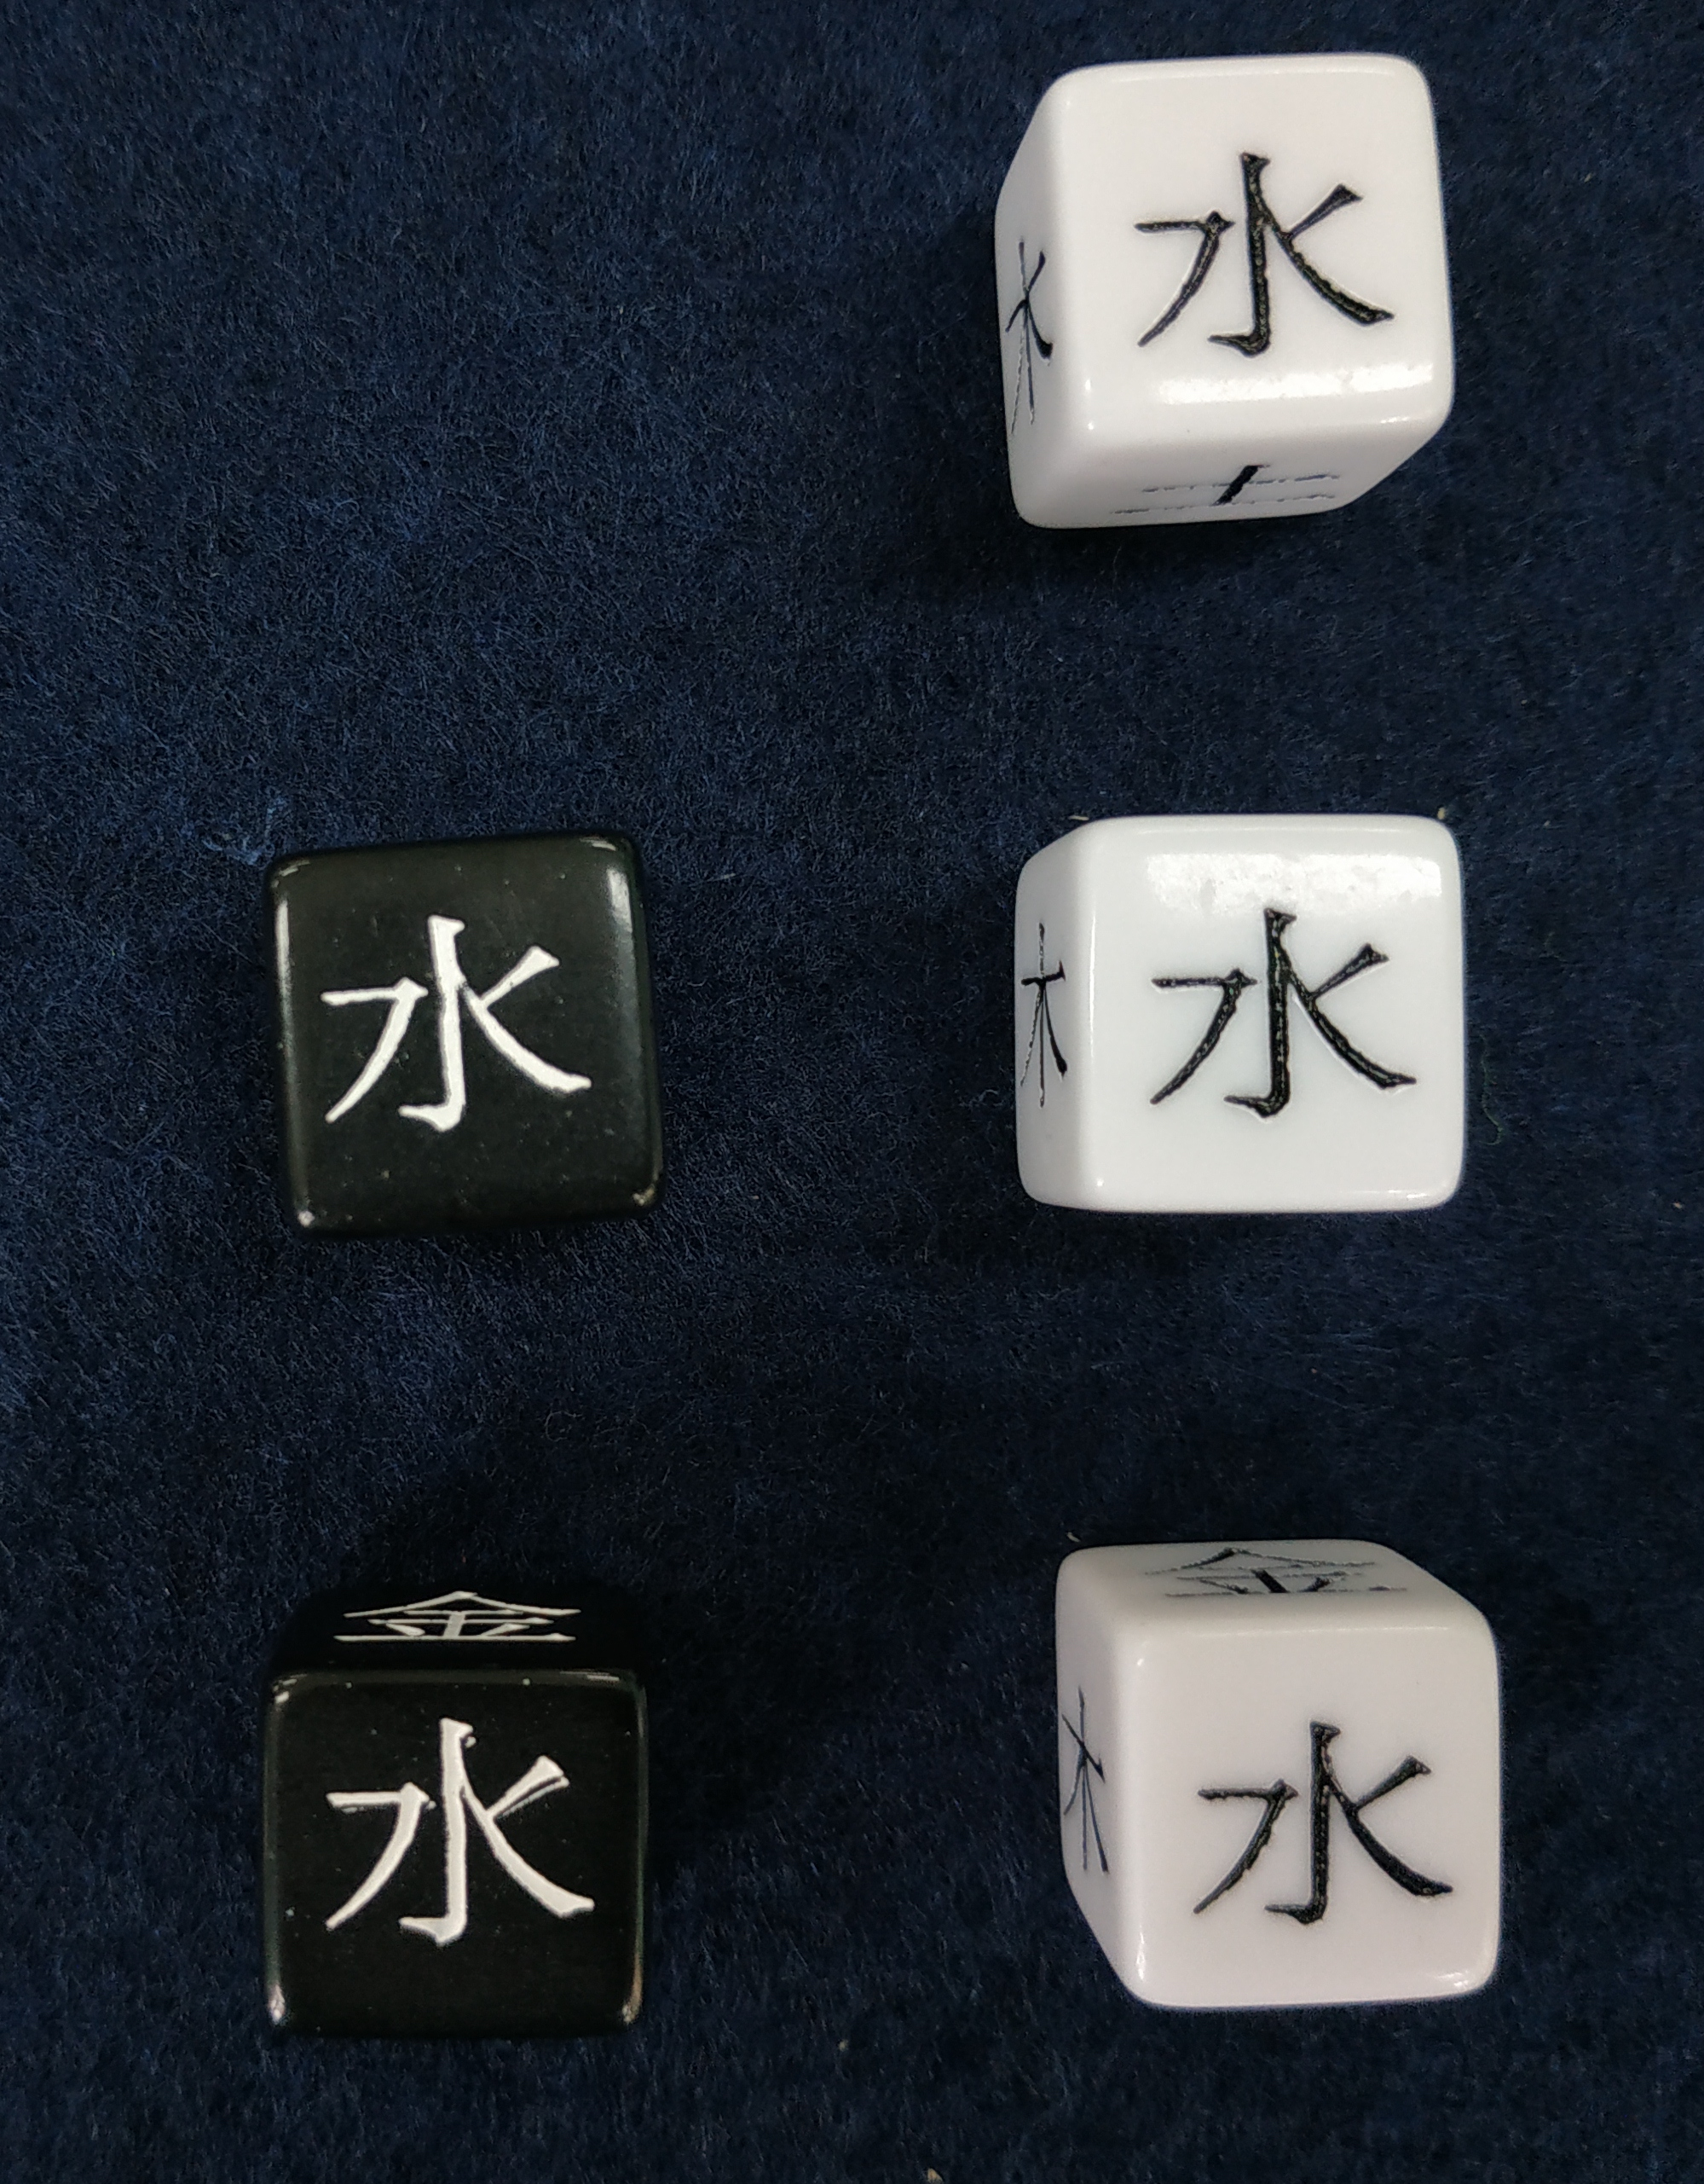
Advantage in a difficult situation
To express the difficulty of a situation while at the same time expressing an advantage for the players, the dice pool consist of
2 Yang dice
3 Yin dice

Slide 10
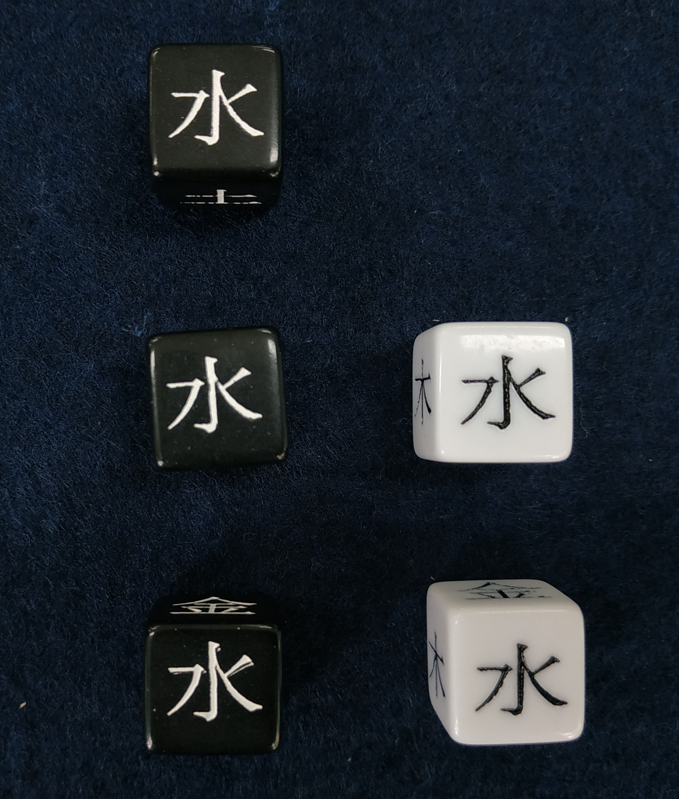
Disadvantage in a difficult situation
To express the difficulty of a situation while at the same time expressing an disadvantage for the players, the dice pool consist of
3 Yang dice
2 Yin dice

Slide 11
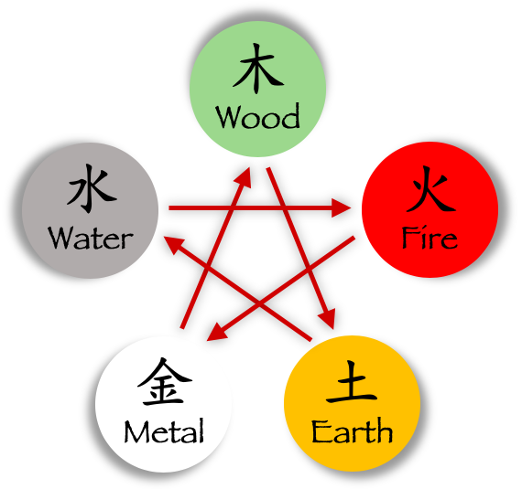
Rules
Balance out Yin & Yang
Eliminate first Yin then Yang elements (➔)
Yang-气: balance out a Yin element, or create your Yang element
Yin-气: automatic failure
Rolling own element enhances effect
resolve consequences (table) or store for setting the next scene
Success: equal amount of Yin & Yang are left, or Yang dominates Yin

Slide 12
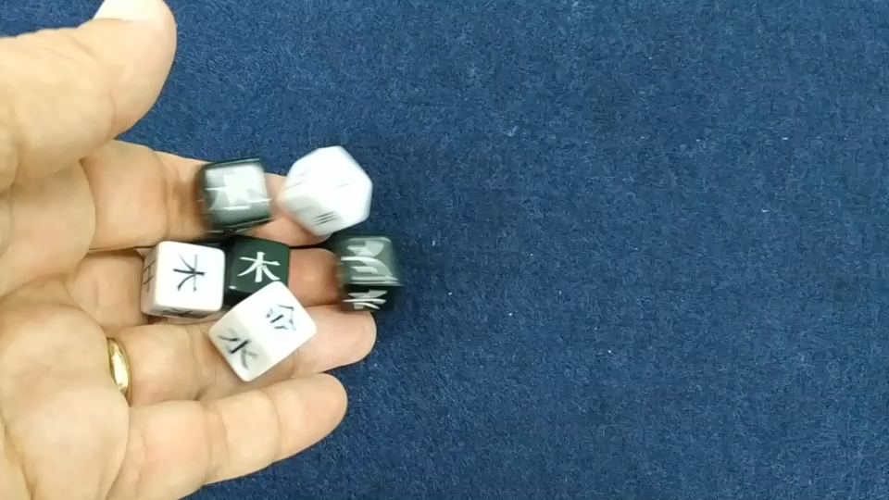
How the rules play out

Slide 13
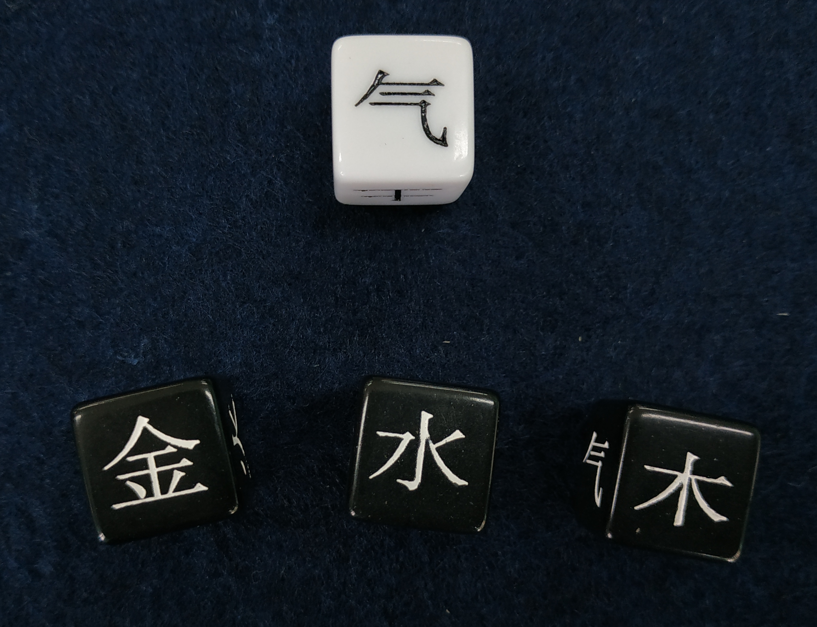
Defining Success
An attempt for an action or to gather information is successful, when
Yang dominates Yin
An equal amount of dice on both sides are left in the roll
No dice remain at the end
A Yang 气 determines success
Even if the attempt is successful, the Yang elements left in the roll represent negative effects.

Slide 14
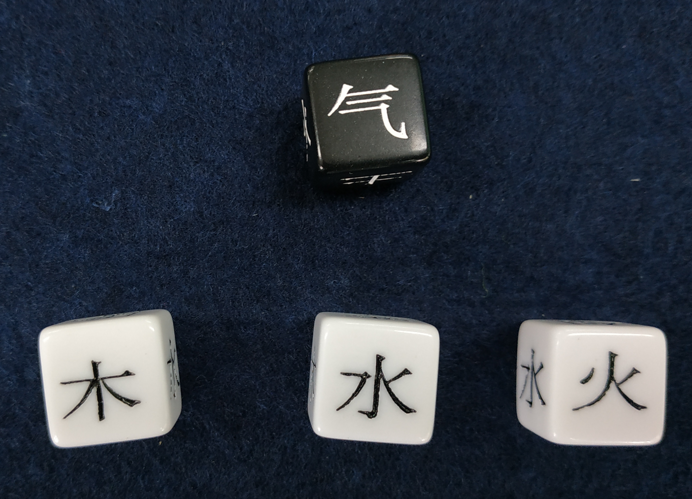
Defining Failure
An attempt for an action or to gather information is a failure, when
Yin dominates Yang
A Yin 气 determines failure
Even if the attempt fails, the Yin elements left in the roll represent positive effects.

